Slide 1
Kids at Hop

Slide 2
Leading with Hope | Dr. Shane Lopez
Hope | The ideas and energy we have for the future:
Hope drives effort, academic achievement, credits earned, and retention of students of all ages.
Hope is more predictive of academic success than traditional measures
Hope items correlate positively with academic achievement and predict academic success in college better than high school GPA and ACT/SAT.
Gallup & Strengths Institute
Notes:
Dr. Lopez’ definition. What are you doing in your district to foster hope in your students

Slide 3
Professor Einstein
We can't solve today's problems by using the same kind of thinking we used when we created them.

Slide 4
Universal Truth # I
Children/youth succeed when they are surrounded by adults who believe they can succeed, NO EXCEPTIONS!

Slide 5
What adults working with kids are telling us…
53% believe all children can succeed no matter what
13% believe their colleagues also believe all children can succeed no matter what
5% believe parents and the community believe all children can succeed no matter what
Kids at Hope Culture Scan Survey
Notes:
The KAH culture scan has been administered to adults working with youth and this is what the aggregate results are telling us –
Only 53% of the adults surveyed can circle a 10. Slightly more than half say they believe in all kids no exceptions and when you begin to modify the questions to include risk factors that number drops - last bullet only 38% believe that most of their students – most not all – will succeed.
Continue to explain the data. If asked, this data reflects approximately 800 responses
What this all means is we have a long way to go to ensure all kids are capable of success, NO EXCEPTIONS but we need to begin with the beliefs and practices of adults.

Slide 6
Universal Truth # II
Children/youth succeed when they have meaningful and sustainable relationships with caring adults
Notes:
Frank coangelo Columbine. Students that had given up. When did disconnect happen?

Slide 7
What adults working with kids are telling us…
50% believe it is a priority in their school that children have a meaningful relationship with the adults on campus
Kids at Hope Culture Scan Survey
Notes:
The KAH culture scan has been administered to adults working with youth and this is what the aggregate results are telling us –
Only 53% of the adults surveyed can circle a 10. Slightly more than half say they believe in all kids no exceptions and when you begin to modify the questions to include risk factors that number drops - last bullet only 38% believe that most of their students – most not all – will succeed.
Continue to explain the data. If asked, this data reflects approximately 800 responses
What this all means is we have a long way to go to ensure all kids are capable of success, NO EXCEPTIONS but we need to begin with the beliefs and practices of adults.

Slide 8
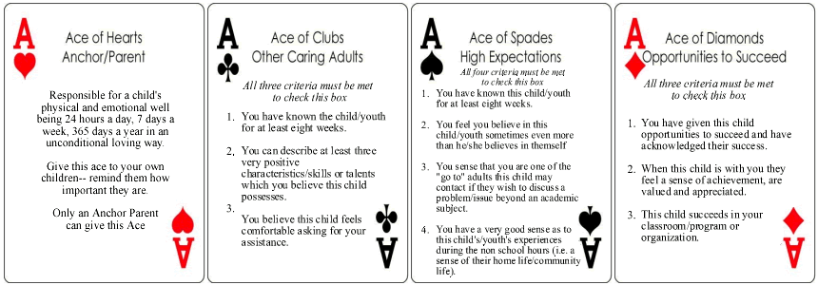
ACES Tracking
On-line ACES Tracking
Notes:
If meaningful & sustainable relationships are part of the literature why don’t we measure them? How do you know? What does the current research show us?

Slide 9
Universal Truth # III
Children/youth succeed when they can articulate their future in more than one destination
Being able to visualize a future is
“mental time travel” and that creates hope.

Slide 10
HOPE
The ability to visit your future-
home & family; education & career; community & service; hobbies & recreation
return to the present and prepare yourself for the journey

Slide 11
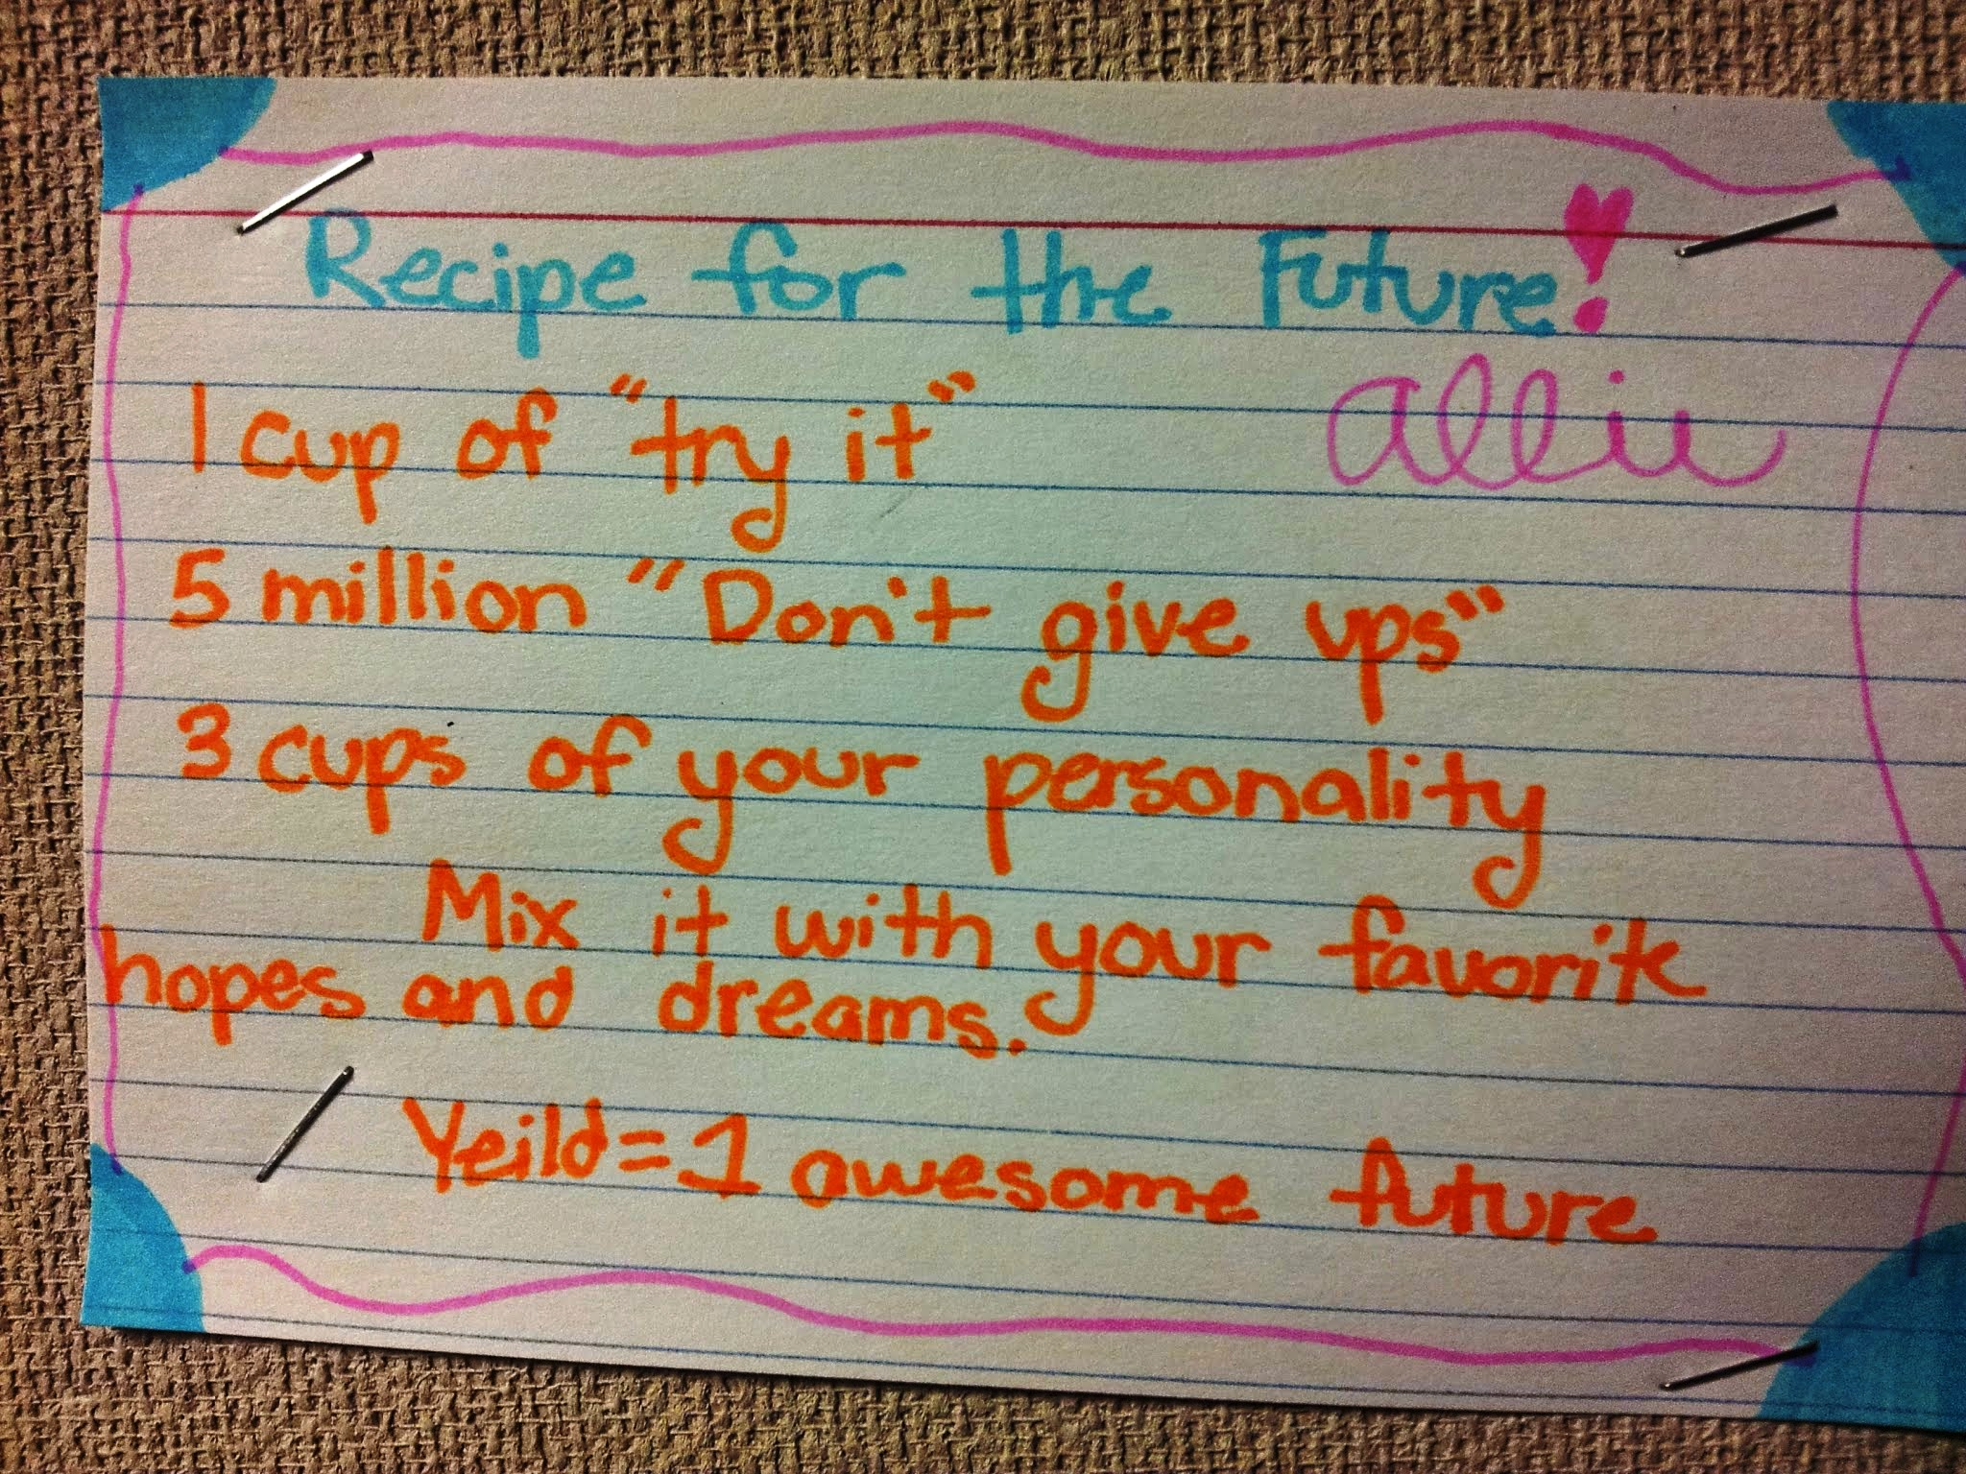

Slide 12
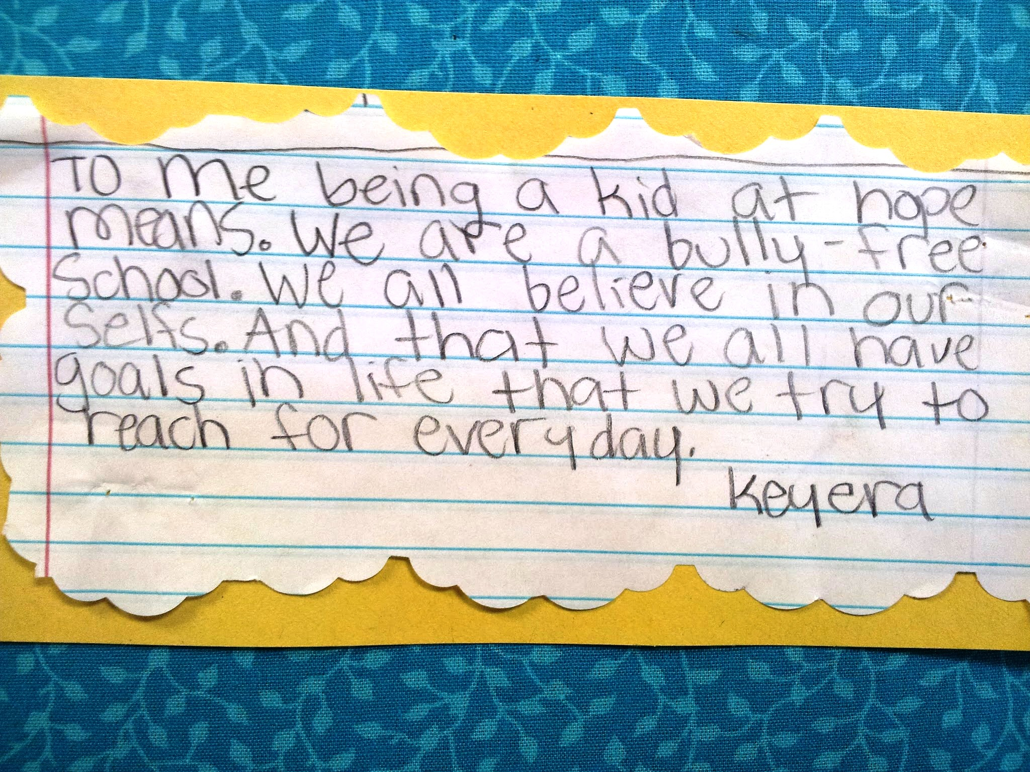

Slide 13
Hope is a Learned Skill
It is not a feeling…
…but a strategy
It is not wishful thinking…
…but a science

